Slide 1

LAHC
CERTIFIED NURSING ASSISTANT PROGRAM (CNA)

Slide 2

Certified Nurse Assistant Program
The Certified Nursing (CNA) provides basic nursing care for patients in
acute, sub-acute, or long-term care facilities. They may also provide basic nursing care for patients in Assisted Living facilities or in patients’ homes. Employment opportunities for CNAs include hospitals, nursing homes, Assisted Living, clinics and home-care agencies.

Slide 3

Why
Become a Certified Nursing
Assistant?

Slide 4
Why Become a CNA?
Job Stability:
The U.S. Bureau of Labor Statistics (BLS) projects approximately 174,000 job openings for CNAs each year between 2019 and 2029.
Ability to Work in Various Sectors:
CNAs can work in nursing care facilities, hospitals, retirement communities and assisted living facilities, home health care facilities and government.
Introduction to Nursing:
Great way to gain experience in the field and can function as a step towards more advanced nursing positions such as Licensed Vocational Nurse or Registered Nurse.
Affordability:
Because CNAs earn a certification rather than a degree, the financial commitment can be far lower. *Can apply for financial aid*
Opportunity for Network Connections:
CNAs work under the supervision of RNs and LPNs. They also assist physicians, nurse practitioners, physician assistants, and other healthcare professionals. The connections made can help with recommendations for future employment or education and career advice.

Slide 5
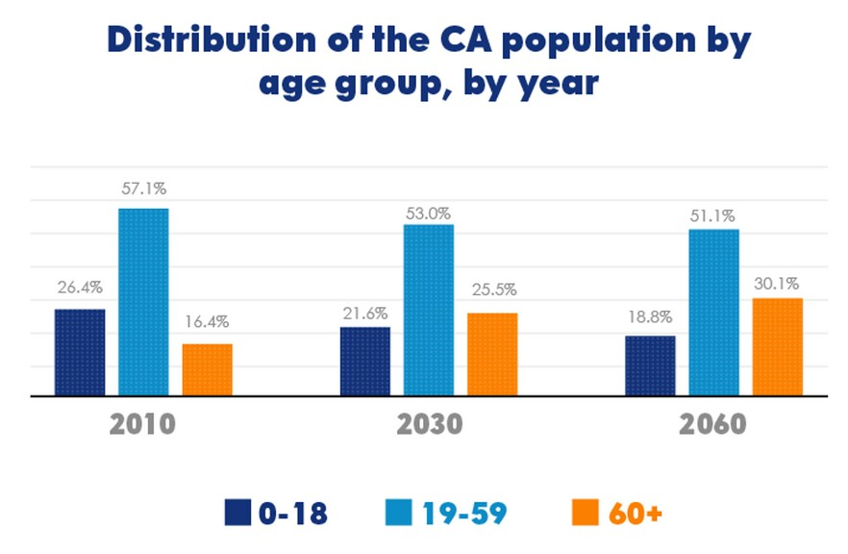
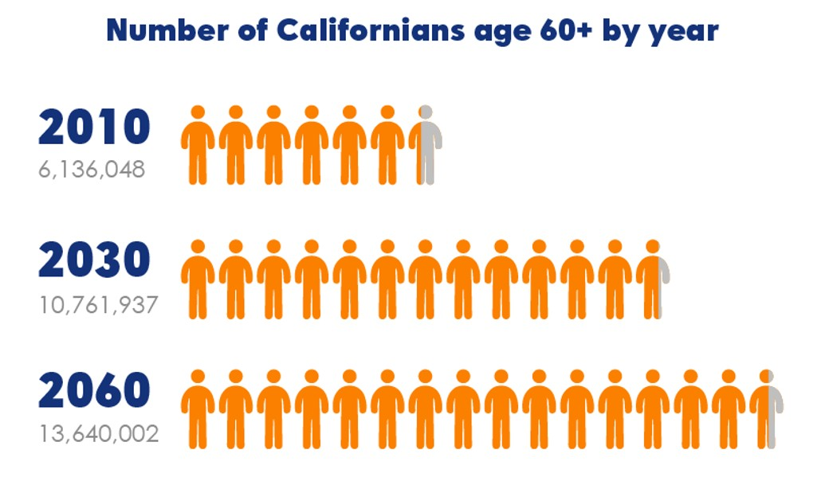
The Future Californian
By 2030, Californians 60 and Over Will Comprise One-Quarter of the Population

Slide 6
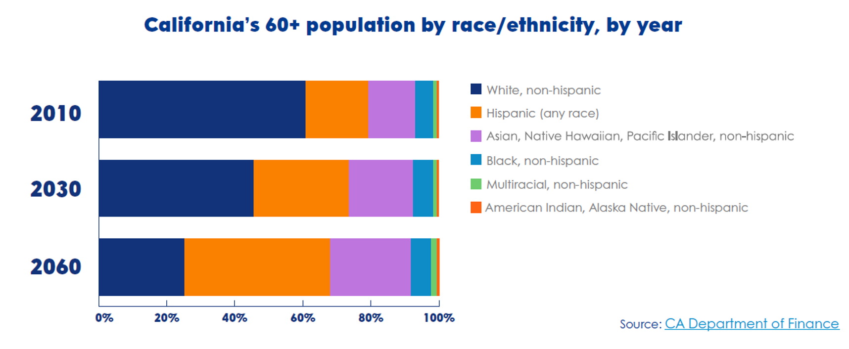
The Future Californian Continueed
This population is becoming more diverse than ever due to the unique make of California

Slide 7

The Future Californian Continueed
COVID-19 pandemic has unmasked inequities in health and human services while also depleting workforces through fatigue and burnout.
Urgent labor shortages are projected to grow even more dire in the future, putting our economic advantage and recovery at risk.
Current lack of representation and diversity: in race, ethnicity, language spoken, LGBTQ+ status, as well as people with lived experience.

Slide 8
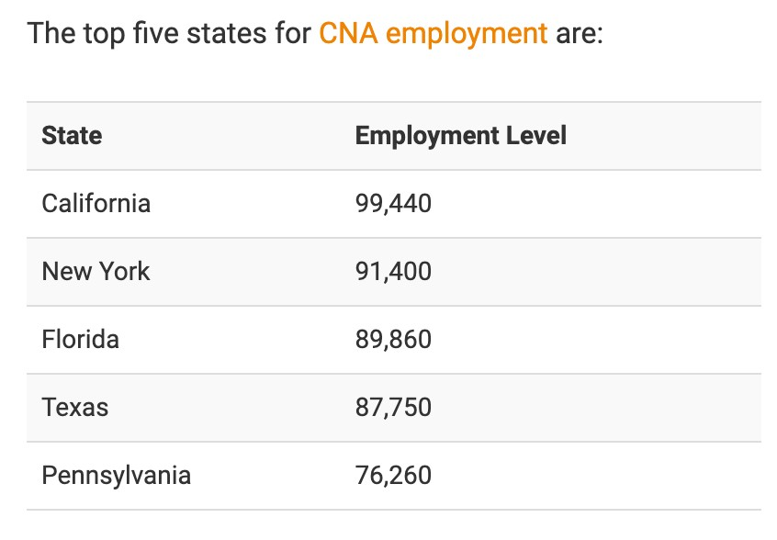
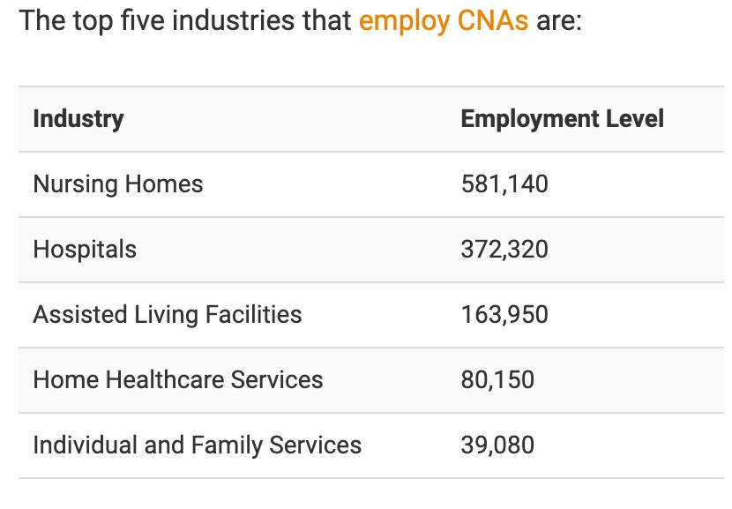
Areas of Occupation

Slide 9



Dependability
Compassion
Providing an understanding ear for your patient, and caring about his or her needs, is a key part of the job.
Teamwork
You will need to work well with not only the patient and the family, but also the nurses, doctors, and other professionals caring for the patient.
CNAs must be reliable and responsible to complete the many tasks required to care for patients.
Communication Skills
Do you enjoy communicating with others? Can you communicate clearly and effectively? This is an important requirement for CNAs.
Composure
CNAs are often in stressful situations. Your ability to manage stress and stay calm will help everyone.

Slide 10

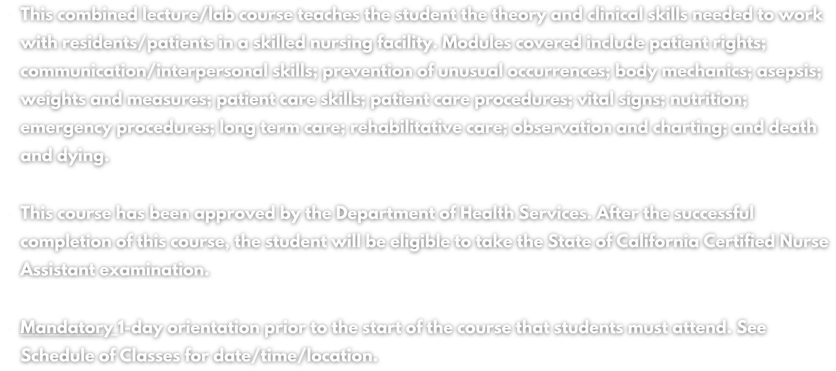
COURSE: NRS-HCA 399A

Slide 11





Program Requirements
Must be a registered student at LAHC and have a social security number and valid state-issued identification.
BLS certification (American Heart Association) *information provided during orientation*
There are mandatory orientations for students prior to the start of the course (Health requirements, uniforms, background checks and class guidlines will be discussed).
Students must undergo a medical history and physical exam and meet requirements for clinical agencies.
Students may not have any health conditions that would create a hazard to self, employees or patients.
Students must provide a clear background check prior to clinical rotation
Student must submit to live scan fingerprinting prior to the start of clinical expierences. (With California Title 22 section 71828 (c) students will not be allowed to participate in clinical expierences if they have been convicted of crimes).

Slide 12

Tuition Fees (6 units) Background Check Uniforms, shoes, gait belt
Wristwatch (w/ second hand)
Health Requirements: Physical & lab tests/vaccines (in case no insurance) First Aid and American Heart Association
Healthcare Provider Base Life Support $75 Malpractice Insurance $24 Blood pressure cuff/stethoscope $35 Textbooks (loaner copies are available) $110 Syllabus $25
State Certification Examination $100 Student Center Fee (ASO) $15
Total Approximate Cost: $1272
$276
$32
$65
$15
Program Approximate Costs
$500
(costs/fees are approximate and subject to change)

Slide 13
Home Health Aide
Course: NRS-HCA 399B- Home Health Aid (2 units)
Prerequisite: Completion of Nursing 399A with a grade of “C” or better.
This combined lecture/lab course teaches the student the theory and clinical skills needed to work with clients in the home care setting. Emphasis is given to safety principles and to methods for providing physical care and emotional and social support. Upon successful completion of this course, the student is eligible to take the certifi cation examination as a Home Health Aide in the State of California.

Slide 14
Program Coordinator: Bernard Llantero
Email: llantebf@lahc.edu
Program Contacts
Program Instructor: Cheri Allmond
Email: allmoncl@lahc.edu
Program Instructor: Deborah Hauser
Email: hauserdm@lahc.edu

